Slide 1



08
March 26-April 1, 2023
Binary Trees, AVL Trees, and Tree Traversals
Notes:
https://pixabay.com/en/man-reading-touchscreen-blog-791049/#_=_

Slide 2
Announcements
Project 3 is due on Tuesday, April 2nd at 11:59pm.
Project 4 will be released on Thursday, April 4th!
Lab 7 AG + quiz due Monday, April 1st at 11:59pm.
Lab 8 handwritten due in lab by Monday, April 1st.
Lab 8 AG + quiz due Monday, April 8th at 11:59pm.
Notes:
LAB 8 TEAM W24: REMOVE BANK IMAGE https://static.wikia.nocookie.net/b__/images/1/17/030-BananaFarm.png/revision/latest?cb=20190522023816&path-prefix=bloons

Slide 3
Lab 7 Handwritten Problem
Prefixes are words that can be followed by some other letters to form a longer word - let's call this final word the successor. For example, the prefix “an” followed by “other” forms the word “another”. Now, given a dictionary consisting of many prefixes and a sentence, you need to replace all the successors in the sentence with the prefix forming it. If a successor has many prefixes that can form it, replace it with the prefix with the shortest length. The input will only have lower-case letters. Return the new sentence in a vector of strings. P prefixes, N words, M length: O(PM + NM²) (Hashing/looking up a string of length M costs O(M))
Example: Prefixes: ["cat", "bat", "rat"] Sentence: [“the”, “cattle”, “was”, “rattled”, “by”, “the”, “battery”] Output: ["the”, “cat”, “was”, “rat”, “by”, “the”, “bat"] vector<string> replace_words(const vector<string>& prefixes,
const vector<string>& sentence);

Slide 4
Handwritten Solution
vector<string> replace_words(const vector<string>& prefixes,
const vector<string>& sentence) {
unordered_set<string> set(prefixes.begin(), prefixes.end()); // O(MP)
vector<string> output;
for (const string& word : sentence) { // N iterations {
string prefix; //
for (char c : word) { // M iterations {
prefix.push_back(c); //
if (set.find(prefix) != set.end()) // O(M)
break; //
} // }
output.push_back(prefix); // O(M)
} // }
return output;
}

Slide 5
Common Mistakes
unordered_map instead of unordered_set
not using range-based constructor
making a new substring each time, rather than having a running substring to add to char by char
forgetting to return result
forgetting to add non-replaced words
not correctly choosing the smallest root to replace
modifying the sentence vector - it’s CONST reference!

Slide 6
Tree Traversals

Slide 7
Tree Terminology
Root: node with no parents
Leaf: node with no children
Internal Node: node with children (including root)
Depth: distance from a node to the root
Height: distance from a node to the lowest leaf node
Siblings: nodes with the same parent node

Slide 8
Warm-Up Question
Given a binary tree with following declaration, find the minimum depth of the binary tree (aka the depth of the shallowest leaf node)
struct Node {
Node* left;
Node* right;
int val;
};
int minimum_depth(Node* root);

Slide 9
Warm-Up Question Solution
Given a binary tree with following declaration, find the minimum depth of the binary tree (aka the depth of the shallowest leaf node)
int minimum_depth(Node* root) {
if (root == nullptr)
return 0;
else if (root->left == nullptr)
return minimum_depth(root->right) + 1;
else if (root->right == nullptr)
return minimum_depth(root->left) + 1;
else
return min(minimum_depth(root->left),
minimum_depth(root->right)) + 1;
}

Slide 10
Tree Traversals
Parent = P, Left Child = L, Right Child = R
Pre-order: PLR
Post-order: LRP
In-order: LPR
Level-order: Traverse all nodes of a level starting at the root and descending in level, traversing from left to right

Slide 11
Preorder Traversal
void traversal(Node* root) {
if(root == nullptr) return;
printNode(root);
traversal(root->left);
traversal(root->right);
}

Slide 12
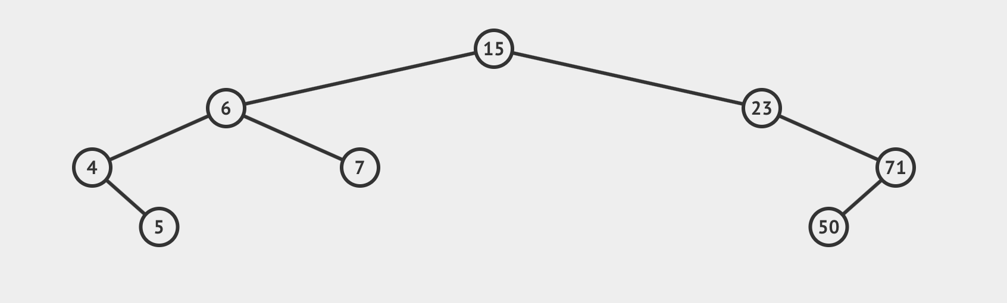
Preorder Traversal
What is the pre-order traversal of this tree?
15, 6, 4, 5, 7, 23, 71, 50
void traversal(Node* root) {
if(root == nullptr) return;
printNode(root);
traversal(root->left);
traversal(root->right);
}

Slide 13
Postorder Traversal
void traversal(Node* root) {
if(root == nullptr) return;
traversal(root->left);
traversal(root->right);
printNode(root);
}

Slide 14
Postorder Traversal
What is the post-order traversal of this tree?
5, 4, 7, 6, 50, 71, 23, 15
void traversal(Node* root) {
if(root == nullptr) return;
traversal(root->left);
traversal(root->right);
printNode(root);
}

Slide 15
Inorder Traversal
void traversal(Node* root) {
if(root == nullptr) return;
traversal(root->left);
printNode(root);
traversal(root->right);
}

Slide 16
Inorder Traversal
What is the in-order traversal of this tree?
4, 5, 6, 7, 15, 23, 50, 71
void traversal(Node* root) {
if(root == nullptr) return;
traversal(root->left);
printNode(root);
traversal(root->right);
}
Notes:
If an in-order traversal is done on a Binary Search Tree, the results will be printed in non decreasing order.

Slide 17
Level-Order Traversal
void traversal(Node* root) {
if(root == nullptr) return;
queue<Node*> discovered { { root } };
while(not discovered.empty()){
Node* node = discovered.front();
discovered.pop();
printNode(node);
if(node->left != nullptr)
discovered.push(node->left);
if(node->right != nullptr)
discovered.push(node->right);
}
}

Slide 18
Level-Order Traversal
What is the level-order traversal of this tree?
15, 6, 23, 4, 7, 71, 5, 50

Slide 19
Practice: Minimum Level Sum
Given a root to a binary tree, find the level of the tree with the minimum sum. The binary tree is not guaranteed to be complete.
Time complexity: O(n)
Memory Complexity: O(logn) average, O(n) worst case
Example: Answer is level 1 (sum = 8)
50
/ \
6 2
/ \ /
30 80 7
Notes:
Log(n) memory comes from having an auxiliary vector<int> to store the sum at each level. Average case: there are O(log(n)) levels in a binary tree. Worst case (stick): O(n) levels.

Slide 20
int minimum_sum(Node* root) {
int minimum_level = 0;
int level = 0;
int minimum_sum = std::numeric_limits<int>::max(); // start min at inf
queue<Node*> q { { root } };
while (not q.empty()) {
int level_size = q.size(); // snapshot of queue holds a full level
int level_sum = 0; // reset level sum
for (int i = 0; i < level_size; ++i) {
Node* temp = q.front(); q.pop();
level_sum += temp->elem; // add element to the level sum
if (temp->left != nullptr) q.push(temp->left);
if (temp->right != nullptr) q.push(temp->right); // push its children
}
if (level_sum < minimum_sum) { // update minimum
minimum_sum = level_sum;
minimum_level = level;
}
++level; // update level
}
return minimum_level;
}

Slide 21
Tree Reconstruction

Slide 22
Reconstruct a Tree Using Traversals
Given the following traversals, draw a tree that would match the traversal results.
In-order: 4, 8, 2, 5, 1, 6, 3, 7
Post-order: 8, 4, 5, 2, 6, 7, 3, 1

Slide 23
Reconstruct a Tree Using Traversals
In-order: 4, 8, 2, 5, 1, 6, 3, 7
Post-order: 8, 4, 5, 2, 6, 7, 3, 1
1
2
3
See the full version of the slides for a walkthrough!
4
5
6
7
8
Notes:
Note: cannot reconstruct from preorder and postorder alone (require in order) Example: Consider root A with left child B vs root A with right child B. Both have preorder AB and postorder BA.

Slide 24
Binary Search Trees

Slide 25
Binary Search Trees
The key of any node is:
≥^{1,2} the keys of all nodes in its left child
≤¹ the keys of all nodes in its right child
Why do we use them? So that we can easily search for and insert items!
Insertion time for best case/worst case/average case? O(1), O(n), O(log n)
Lookup time for best case/worst case/average case? O(1), O(n), O(log n)
¹ These can be strengthened to strict relational inequality when no two keys in the tree can compare equivalent
² For the purpose of this lab's AG assignment, this is strict greater-than

Slide 26
BST Insertion and Deletion
Insertion - Average O(logn); Worst Case O(n)
Start at root and traverse downwards (based on node’s value) until a spot to append the node is found
Deletion - Average O(logn); Worst Case O(n)
If the node has 1 child:
replace it with its child and delete child
If the node has 2 children:
replace it with its inorder successor (or predecessor)
remove the in-order node from its original spot in tree and replace it with its child if it has one
Notes:
in-order successor - (from parent:) once right, then all the way left
in-order predecessor - (from parent:) once left, then all the way right

Slide 27
Binary Search Trees: Insert
Insert the following to the BST: 3 5 6 9
8
4
10

Slide 28
Binary Search Trees: Insert
Insert the following to the BST: 3 5 6 9
8
8
4
4
10
10
3
5
9
6

Slide 29
Binary Search Trees: Delete
Delete the following from the BST: 5 4 8 11
8
4
10
3
5
9
11
6

Slide 30
Binary Search Trees: Delete
Delete the following from the BST: 5 4 8 11
Replace with in order successor / in order predecessor
6
9
3
10
6
10
9
3
inorder predecessor
inorder successor
Notes:
Come back to this and see if they can balance them - they already are balanced, so no need

Slide 31
Binary Search Trees
What does it mean for a tree to be balanced about a node k?
The heights of the children of k differ by at most 1
What does it mean for a tree to be balanced?
It's balanced about every node
In other words, it's balanced about the root and the root's children are balanced
What can we say about the complexities of insert and search in a balanced tree?
Worst case becomes O(log n)
Notes:
Balanced: for every node k of T, the heights of the children of k differ by at most 1

Slide 32
AVL Trees

Slide 33
AVL Trees
Self-balancing BST
Maintain balance with each insertion and deletion
Have average and worst case search/insert/delete complexities of O(log n)
Invariants
The value of a node is > than the values of all its nodes in its left subtree and <= the values of all of the nodes in its right subtree (i.e. it is a BST!)
The balance factor of each node must be in the range [-1, 1]
Balance factor(node) = Height(left subtree) – Height(right subtree)

Slide 34
AVL Trees: Insertion and Deletion
Insertion - O(logn)
Insert the node in its appropriate location without considering imbalances (same as BST!)
Determine whether there is an imbalance in any node starting from the inserted node and moving up to the root and rotate if necessary. Once you’ve rotated “once” (might be a double rotation), you’re done!
Deletion - O(logn)
Delete like a BST
Rearrange tree to balance height
Start at parent of deleted node and work up
At the first unbalanced node encountered, rotate as needed

Slide 35
Trees: Moving Up
Moving down in a tree is easy. Recurse to a child.
Moving up is not so straightforward… but we said in the last slide that it's necessary!
Recall postorder traversals. They visit the root last. How?
Visit the root after traversing a child, as recursion unwinds.
Information can be passed:
down the tree as arguments to recursive calls
up the tree as return values from recursive calls

Slide 36
AVL Rotation Case 1 (+,+)
Left subtree causes imbalance and left side of that subtree has extra node
Insertion Order:
4, 3, 5, 2, 1
4
4
+2
3
5
Rotate Right
2
5
2
+1
1
3
1

Slide 37
AVL Rotation Case 2 (–,–)
Right subtree causes imbalance, and right side of that subtree has extra node
Insertion Order:
2, 1, 3, 4, 5
2
2
1
3
-2
Rotate Left
1
4
4
-1
3
5
5

Slide 38
AVL Rotation Case 3 (+,–)
Left subtree causes imbalance, and right side of that subtree has extra node
Rotate Left
Rotate Right
4
4
4
+2
3
5
+2
5
3
2
5
1
-1
+1
2
1
3
2
1
Insertion Order:
4, 5, 3, 1, 2

Slide 39
AVL Rotation Case 4 (–,+)
Right subtree causes imbalance, and left side of that subtree has extra node
Rotate Right
Rotate Left
2
2
2
1
3
-2
1
3
1
4
-2
+1
4
5
-1
3
5
4
5
Insertion Order:
2, 1, 3, 5, 4

Slide 40
AVL Rotation
Node that moves up has 2 children! → The node that moves down gets the other child
If rotating left: node gets left child on its right side
If rotating right: node gets the right child on its left side
Insertion Order:
2, 1, 4, 3, 5, 6
RL(2)
2
-2
4
1
4
-1
2
5
3
5
1
3
6
6
Notes:
You do it this way because you know two things for sure:
1) The lower node’s left child will be greater than the node whose place it is taking
2) The node who gets the child will have room for a right child because its right child pre-rotation is the node that is taking its place

Slide 41
AVL Rotation
Node that moves up has 2 children! → The node that moves down gets the other child
If rotating left: node gets left child on its right side
If rotating right: node gets the right child on its left side
4
See the full version of the slides for a walkthrough!
2
5
1
3
6
Notes:
You do it this way because you know two things for sure:
1) The lower node’s left child will be greater than the node whose place it is taking
2) The node who gets the child will have room for a right child because its right child pre-rotation is the node that is taking its place

Slide 42
AVL Trees Practice Problem
5
Delete node 5 and then delete node 7. What does the resulting tree look like?
Assume we use in-order successor.
3
7
1
4
6
8
2

Slide 43
AVL Trees Practice Problem
Answer:
3
1
6
2
4
8

Slide 44
Handwritten Problem

Slide 45
Handwritten Problem: Background
Let’s say the diameter of a tree is the maximum number of edges on any path connecting two nodes of the tree. For example, here are three sample trees and their diameters. In each case the longest path is bolded and shown in purple. Note that there can be more than one longest path.
A B C / \ / \ D E F G / / / \ H I J K \ / L M | A / \ B C / / \ D E F / \ \ G H I / \ J K | A C / E / \ G H / J
Diameter: 8 | Diameter: 6 | Diameter: 4

Slide 46
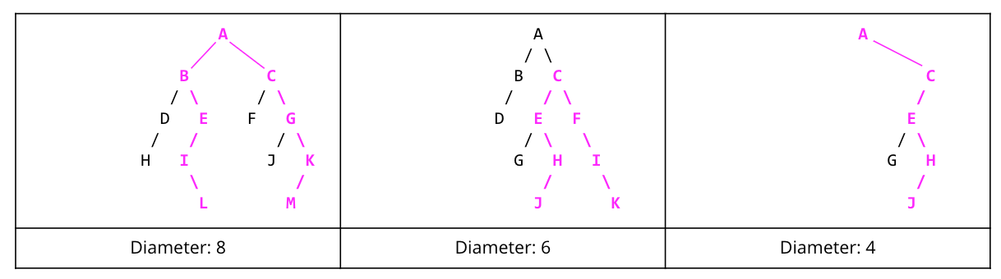
Handwritten Problem
Consider the following Node definition of a binary tree: class BinaryTreeNode { public: BinaryTreeNode* left; BinaryTreeNode* right; int value; BinaryTreeNode(int n) : value(n), left(nullptr), right(nullptr) {} };
Your task: Implement the diameter function that computes the diameter of a binary tree represented by a pointer to an object of type BinaryTreeNode. Assume that an empty tree or a missing child will be represented by nullptr. Do not modify the definition of the BinaryTreeNode class. You may write one or more helper functions if you need.
Implement diameter in O(n²) or better time (try doing it in O(n)!).
int diameter(const BinaryTreeNode* tree) { }
Notes:
the exclamation mark is outside the parentheses, so that’s O(n) said very excitedly, not O(n!)

